Slide 1
Обзор технологий секвенирования ДНК

Slide 2
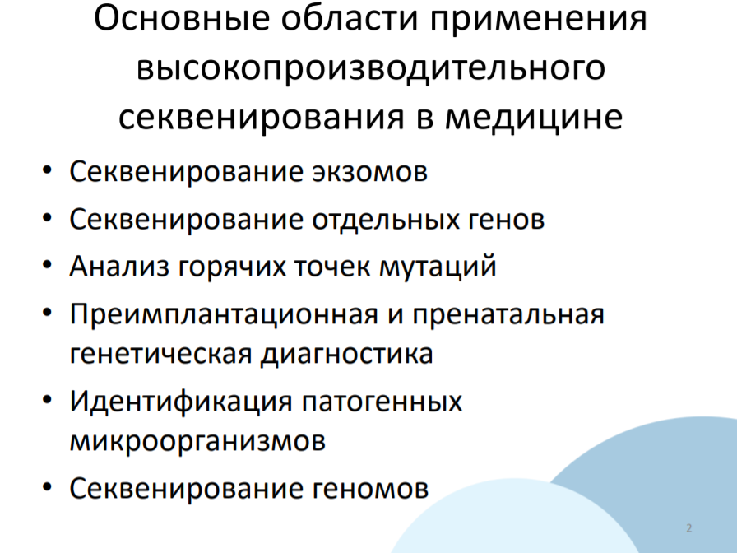

Slide 3
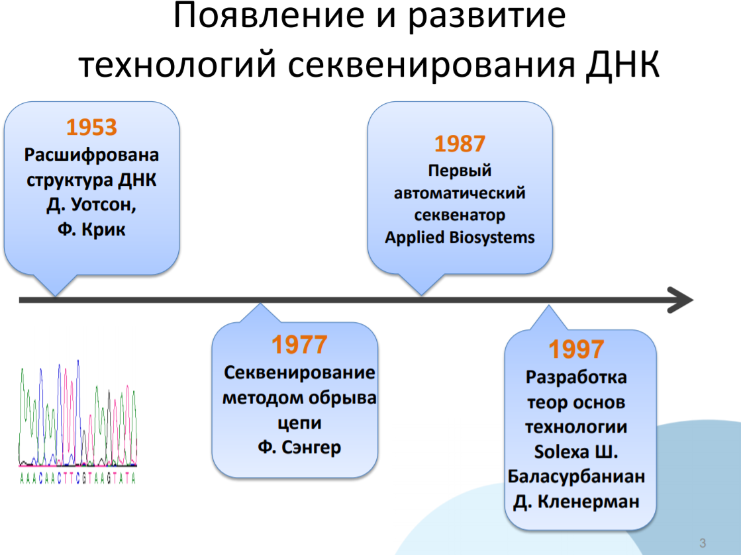

Slide 4
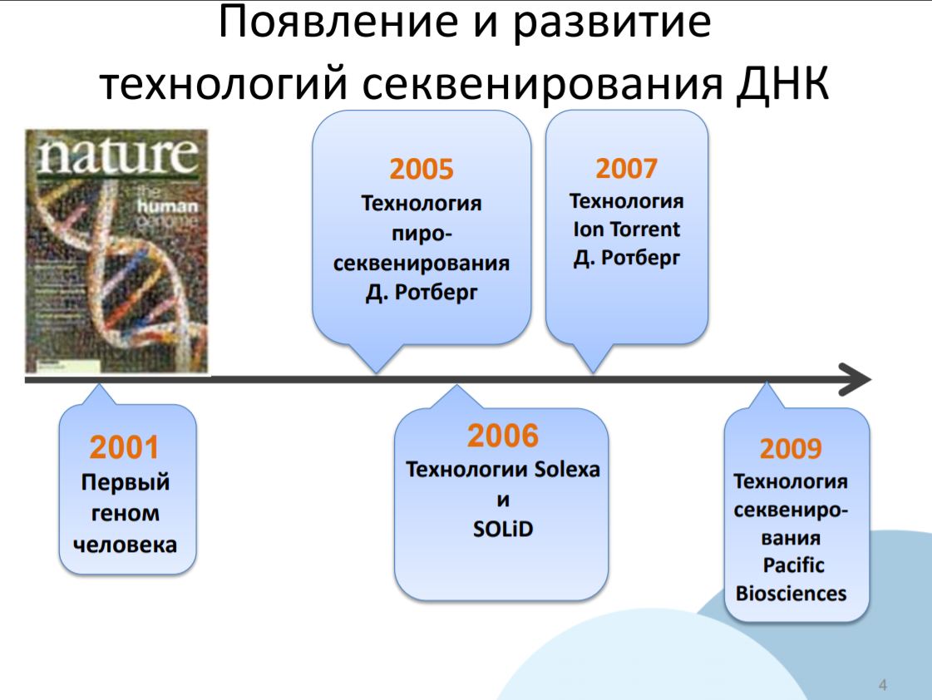

Slide 5
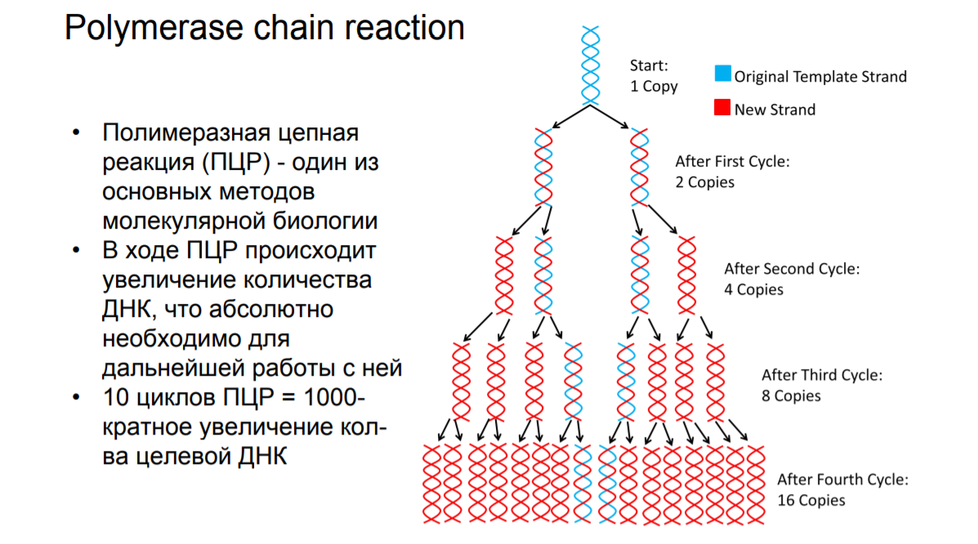

Slide 6
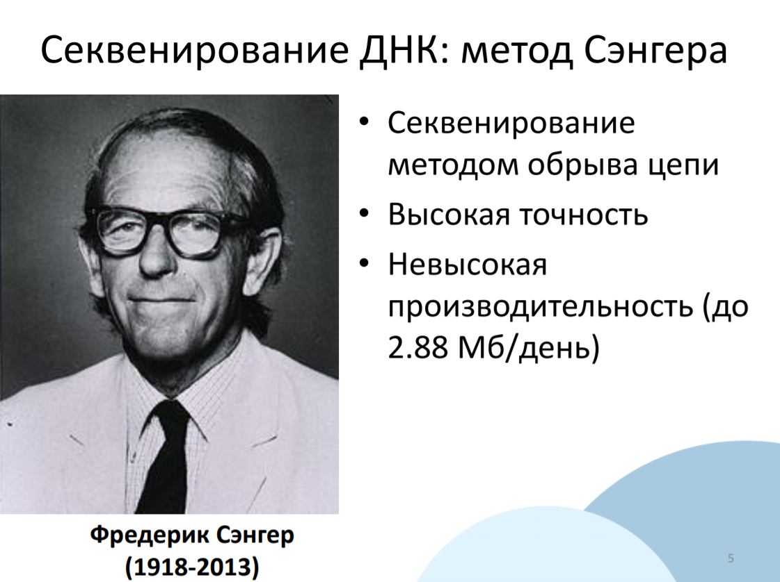

Slide 7
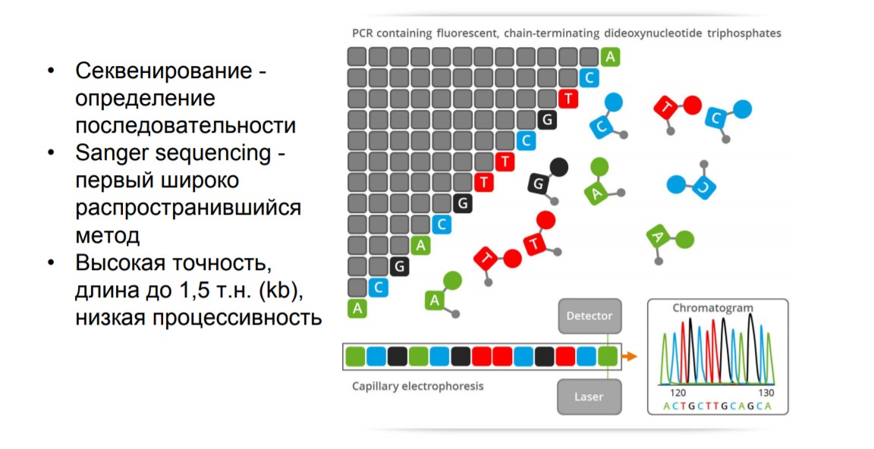

Slide 8
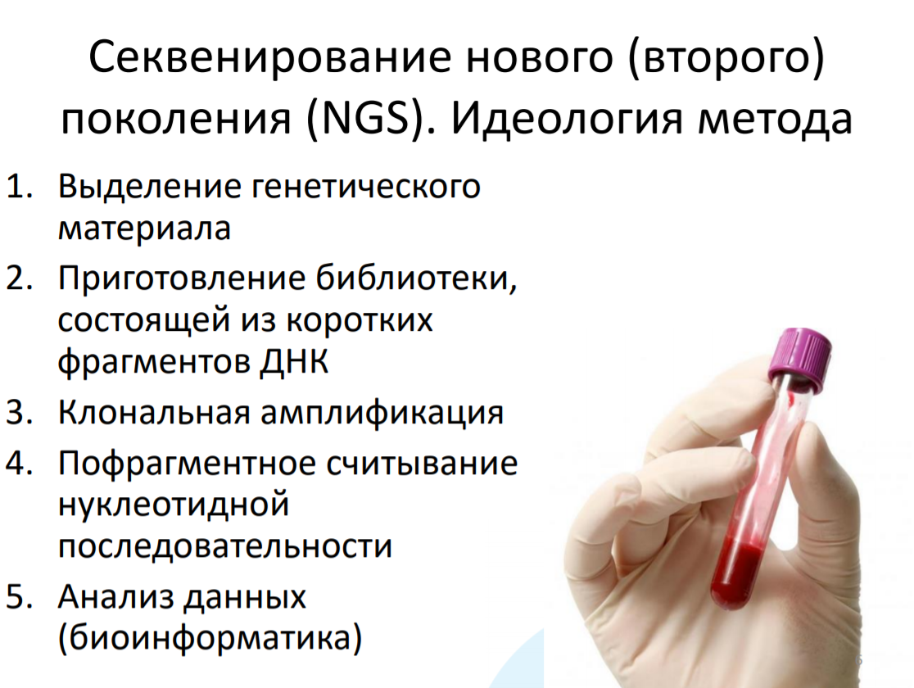

Slide 9


Slide 10
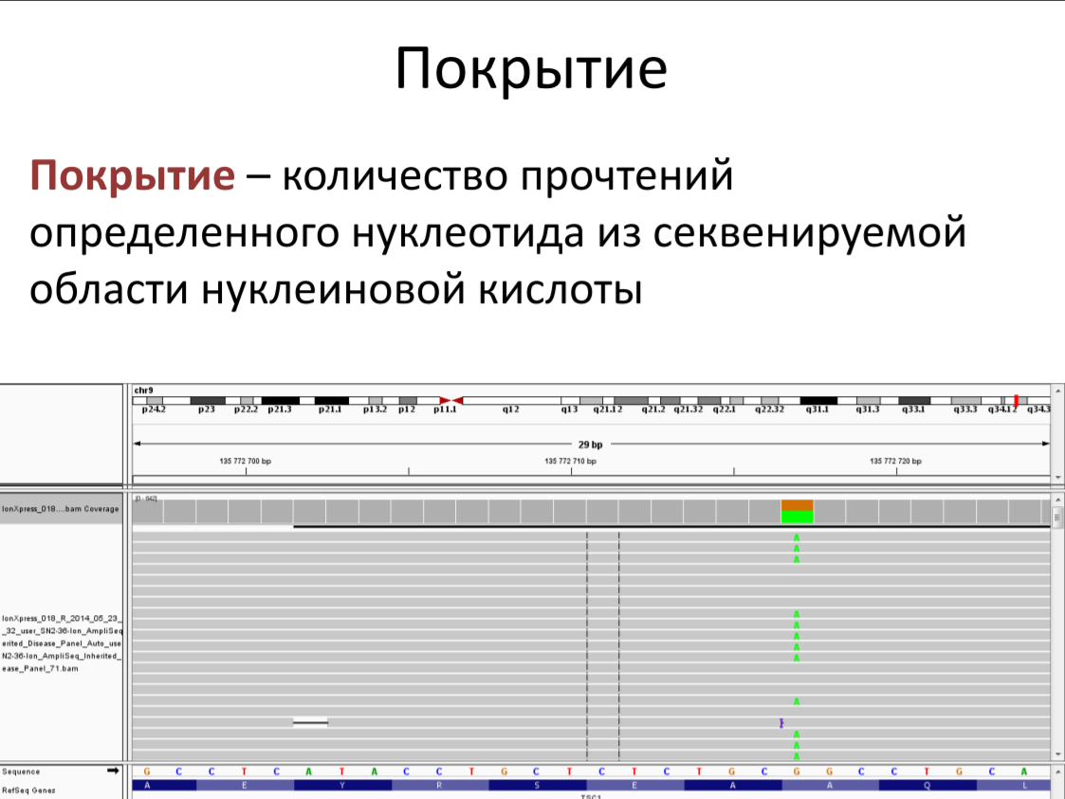

Slide 11
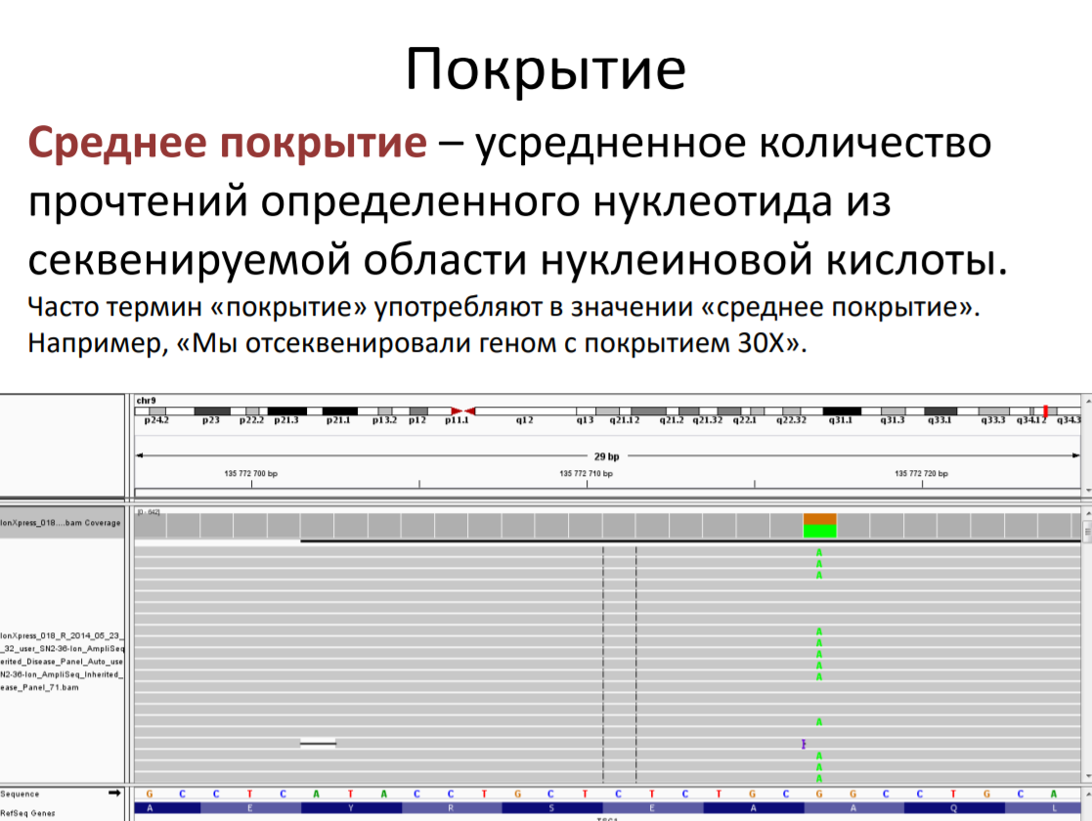

Slide 12
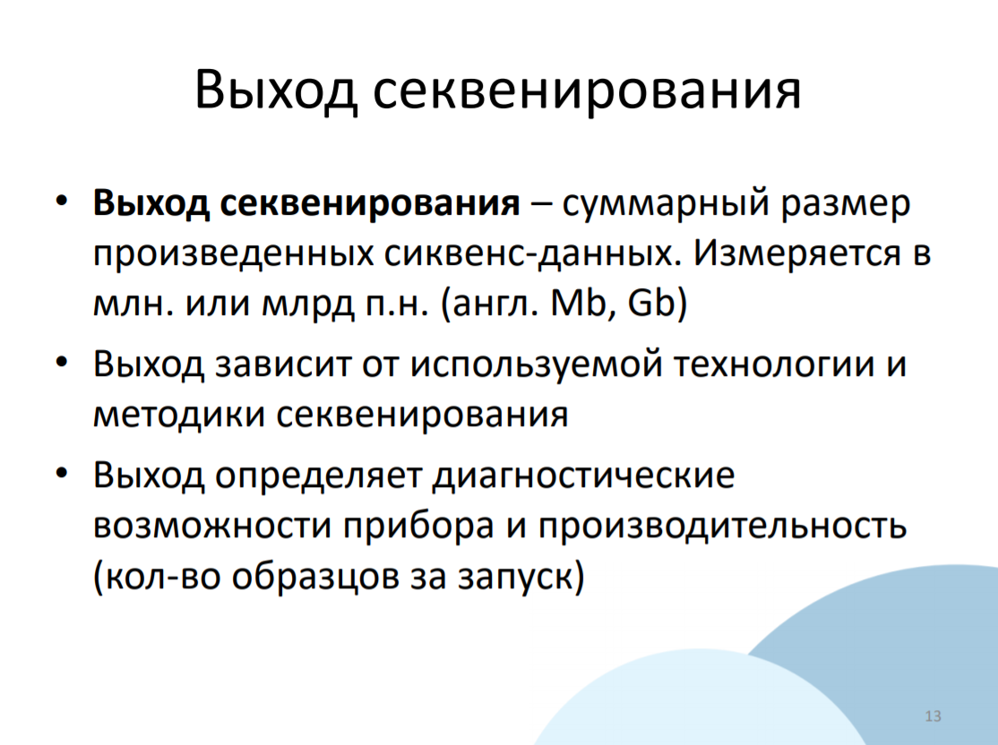

Slide 13
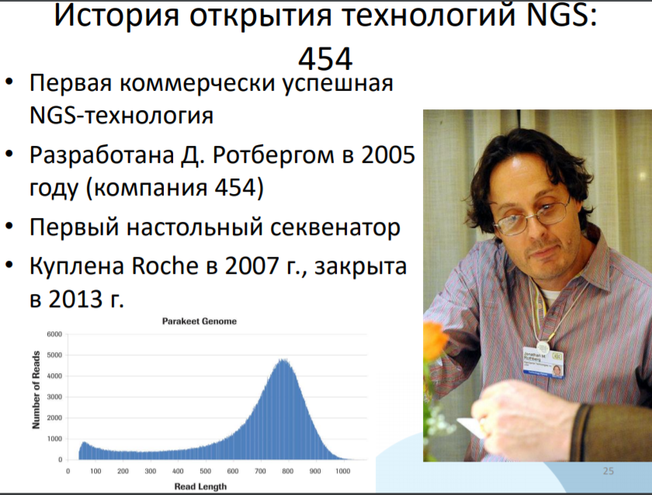

Slide 14

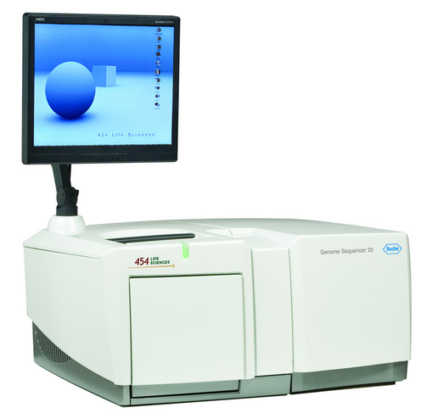
Первый геномный секвенатор
GS 20 System
2005 г.
10…20 млн.п.о.

Slide 15

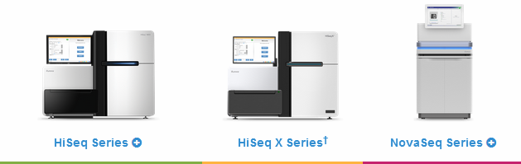

Cеквенаторы компании Illumina
Полногеномные (WGS)
Настольные (таргетные)
https://www.illumina.com/systems/sequencing-platforms.html

Slide 16





Стоимость WGS
$999
(06.03.2016)
€850
(24.04.2017)
$600
(04.09.2017)
€649.00
(07.2017)
https://www.veritasgenetics.com/mygenome
https://www.dantelabs.com/products/whole-genome-sequencing

Slide 17





Эволюция геномных проектов
Project Jim 2005…2007
(1 геном)
100,000 Genomes Project 2013…2018
(0,1 млн. геномов)
Precision Medicine Initiative (PMI) 2016…2019
(1 млн. геномов)
China Precision Medicine Initiative 2016…2030
(100 млн. геномов)
“Нацпроекты”
Saudi human genome project (SGP) ~ 33 млн. геномов
Qatar genome project (QGP) ~ 0,3 млн. геномов
Iceland’s Genome Project ~ 0,3 млн. геномов
Korea's Personal Genome Project ~ 51 млн. геномов
Notes:
Началом эры геномного секвенирования можно считать 1990 год – первый год выполнения проекта «Геном человека», на который США планировали потратить 3 миллиарда долларов за 15 лет. Но проект был завершён досрочно из-за компании «Celera», создавшей крупный геномный центр («100 секвенаторов,100 компьютеров и 100 китайцев»). В результате геном усреднённого человека, хотя и с низким качеством, удалось секвенировать за 2 года и за $200 миллионов долларов.
Первый индивидуальный геном человека, принадлежащий Джеймсу Уотсону, был оцифрован после появления в 2005 году первого геномного секвенатора. Этот проект (“Project Jim”) также занял 2 года, но потрачено не него было в 100 раз меньше - 2 миллиона долларов. Практически одновременно с его завершением (в 2007 году) появился первый флуоресцентный секвенатор, и к 2008 году стало возможным выполнение проекта, нацеленного на секвенирование тысячи индивидуальных геномов. А в 2012 году в Великобритании запустили проект секвенирования уже 100 тысяч геномов, причём выделено на это было всего лишь 100 миллионов фунтов стерлингов (по £1000 за геном).
В 2016 году в США стартовал проект PMI (Precision Medicine Initiative), нацеленный на секвенирование геномов миллиона американцев. Потратить на него планируют более миллиарда долларов (2016 год - $215 млн.; 2017 г. – $309 млн.).
Но и это уже не самый крупный проект, поскольку некоторые страны нацелились на тотальное секвенирование своего населения.

Slide 18




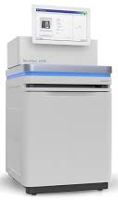
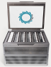
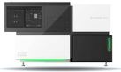
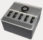
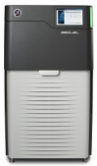
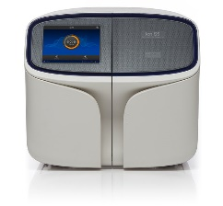
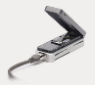
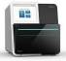
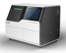
Секвенаторы 2018 года
1 Tbp
PromethION
NovaSeq 6000
BGISEQ-500
GridION X5
10 Gbp
MinION
Ion S5
Sequel
BGISEQ-50
MiniSeq

Slide 19


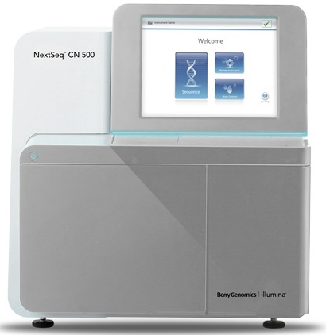

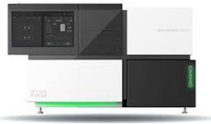

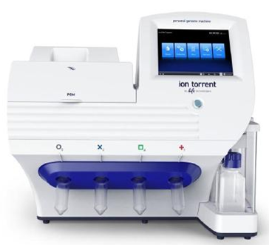
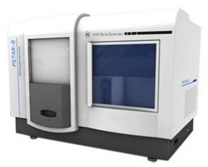
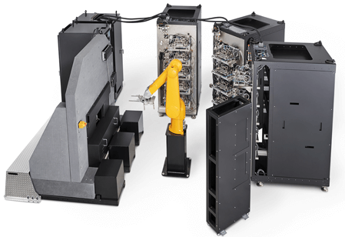



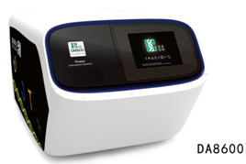
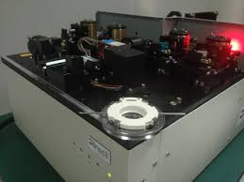
Особенности национального секвенирования
NextSeq CN500
BGISEQ-50
BGISEQ-100
BGISEQ-500
HYK-PSTAR-IIA
(Direct Genomics)
BGISEQ-1000
Bioelectron Seq4000
DA8600
GenoCare

Slide 20

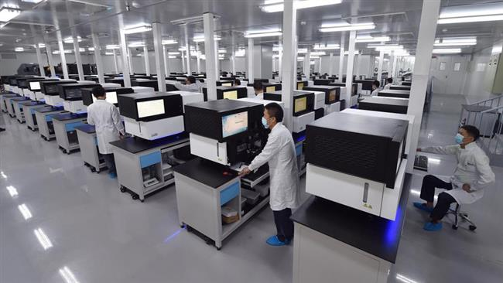
China National GeneBank
(CNGB)
http://www.presstv.com/Detail/2016/09/22/485893/China-national-gene-bank

Slide 21
Секвенирование - 2018
Годовые объёмы финансирования мегапроектов и нацпроектов по WGS измеряются сотнями миллионов долларов
Стоимость WGS уменьшилась до $600 за геном
Экзомное секвенирование вытесняется полногеномным
В борьбу за рынок NGS включилась технология нанопорового секвенирования
Увеличение разрыва между лидерами и аутсайдерами геномных гонок привело к кризису полупроводникового и SMRT секвенирования
Определилась тройка лидеров геномных гонок (Illumina, BGI и ONT)
Неоспоримое лидерство США в геномных гонках оспорили Китай и Великобритания

Slide 22
How Does Illumina Sequencing Work?

Slide 23
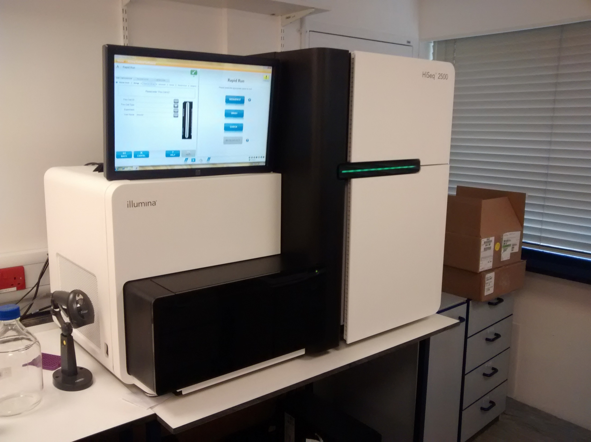

Slide 24
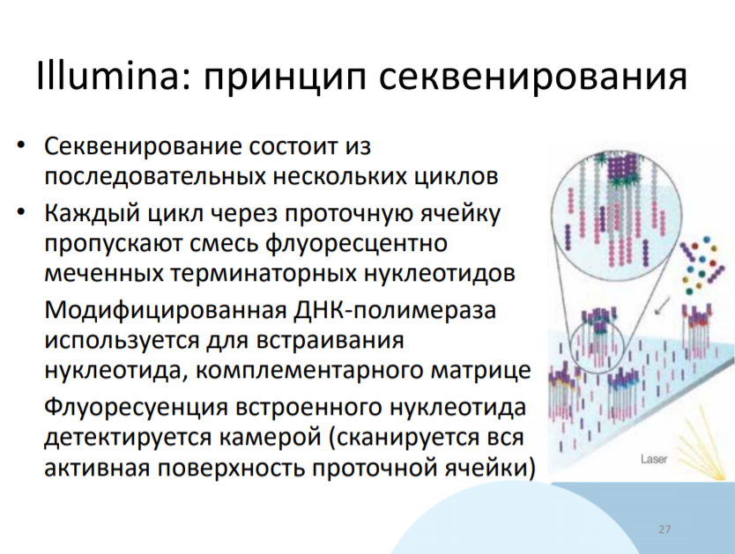

Slide 25
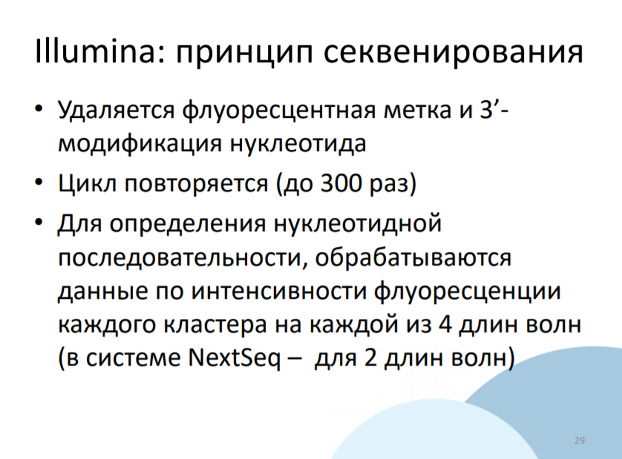

Slide 26
Microscope
Fridge
Pumps

Slide 27
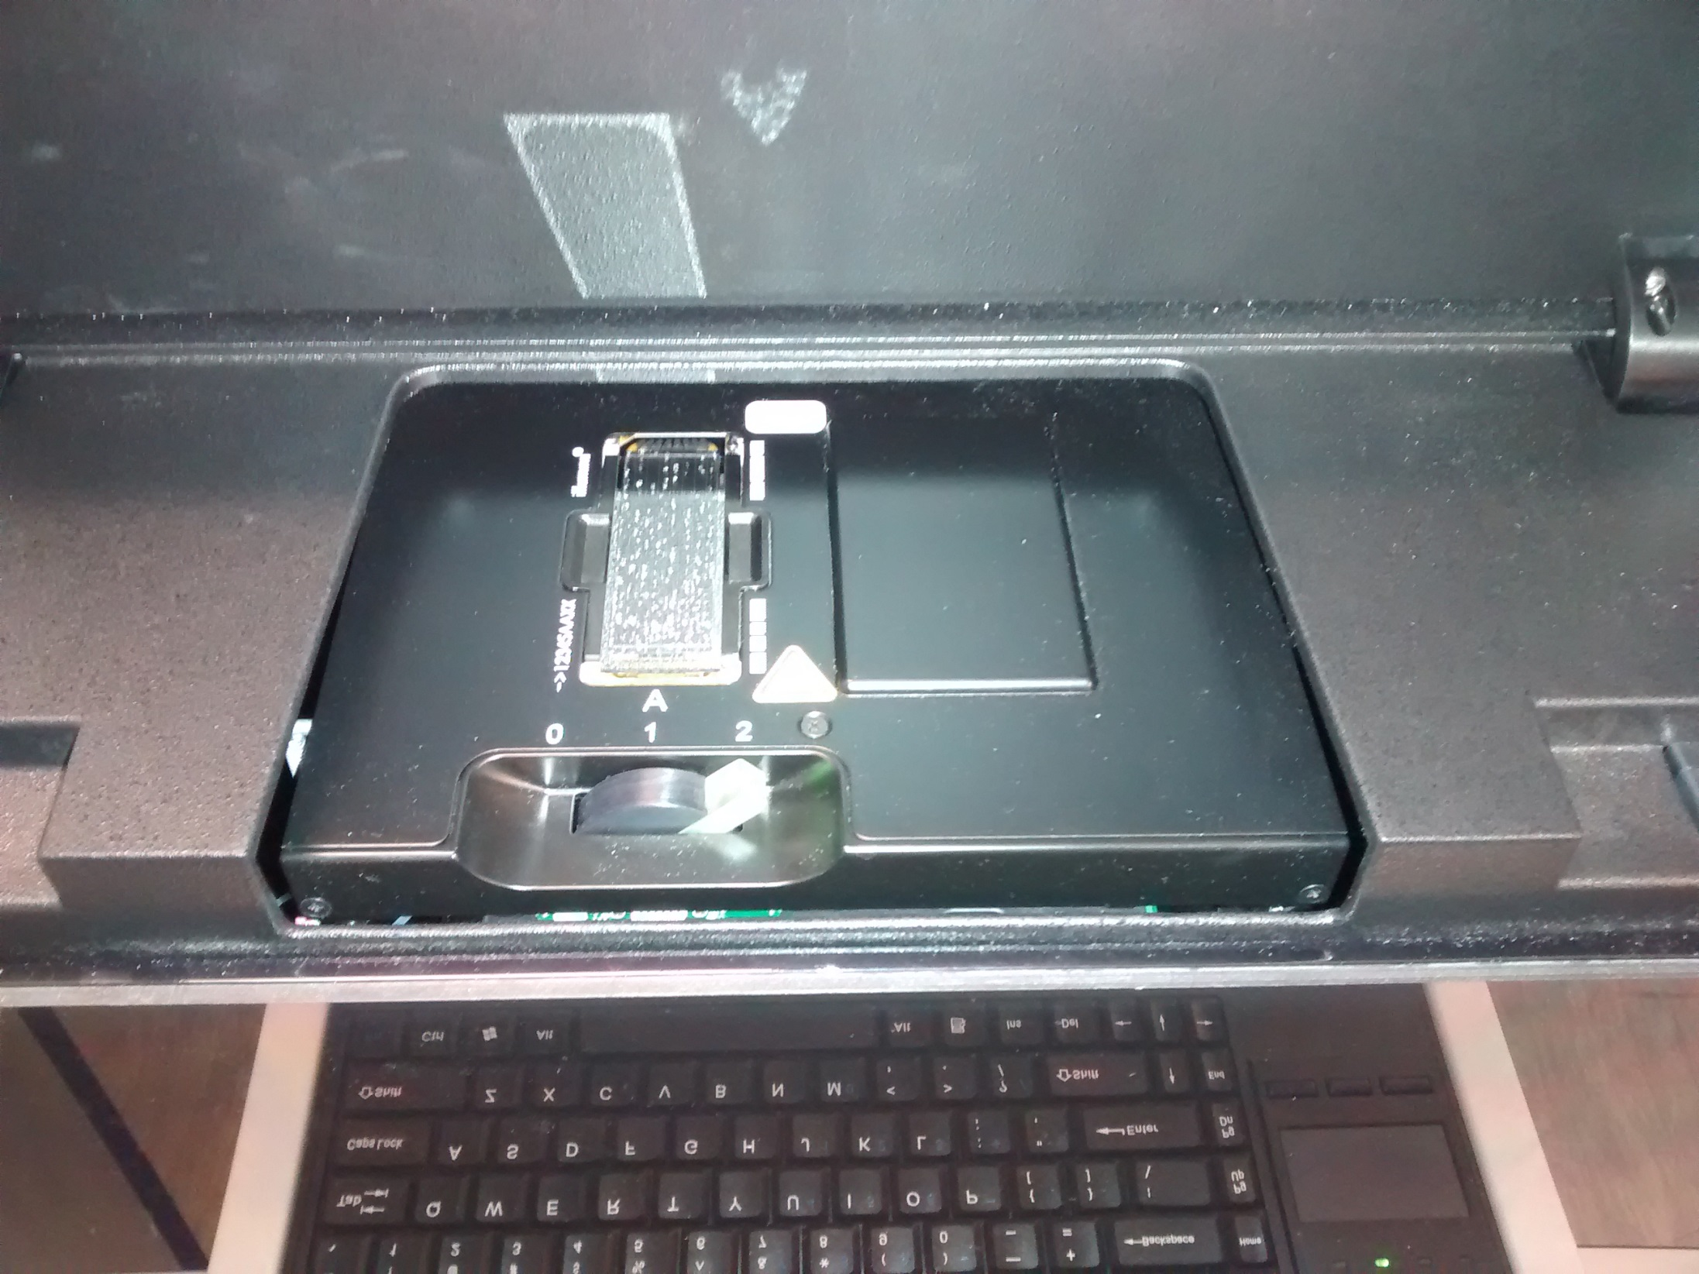

Slide 28
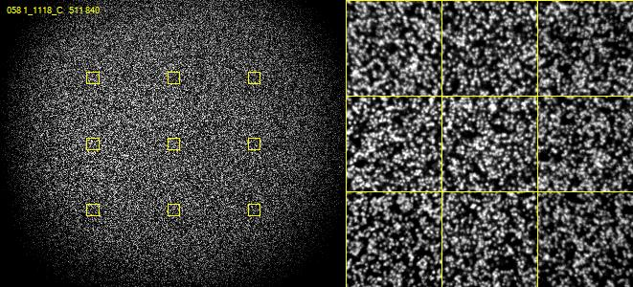
Real Illumina Sequence Data

Slide 29
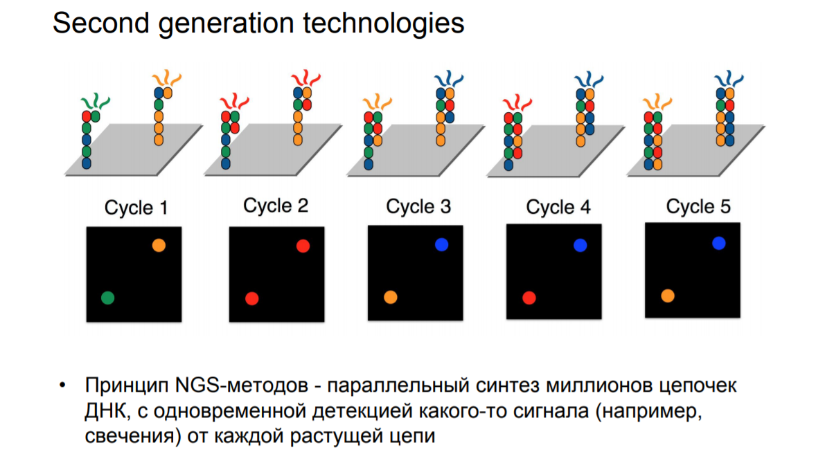
Single molecule attaches randomly*
Bridge amplification amplifies*
Cluster of identical (ish) molecules created
*Newer sequences (x10 and HiSeq4000 use bead guided positioning and isothermal expansion)

Slide 30
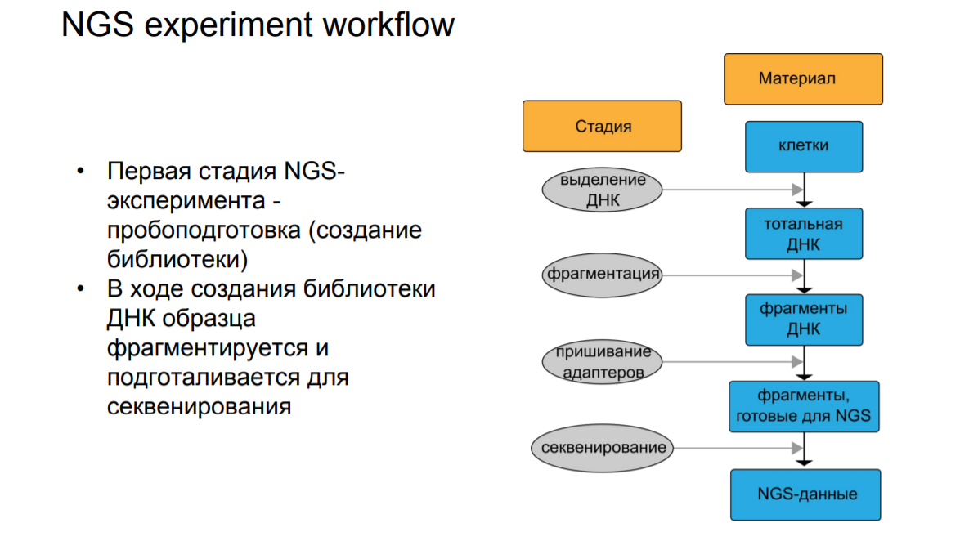

Slide 31
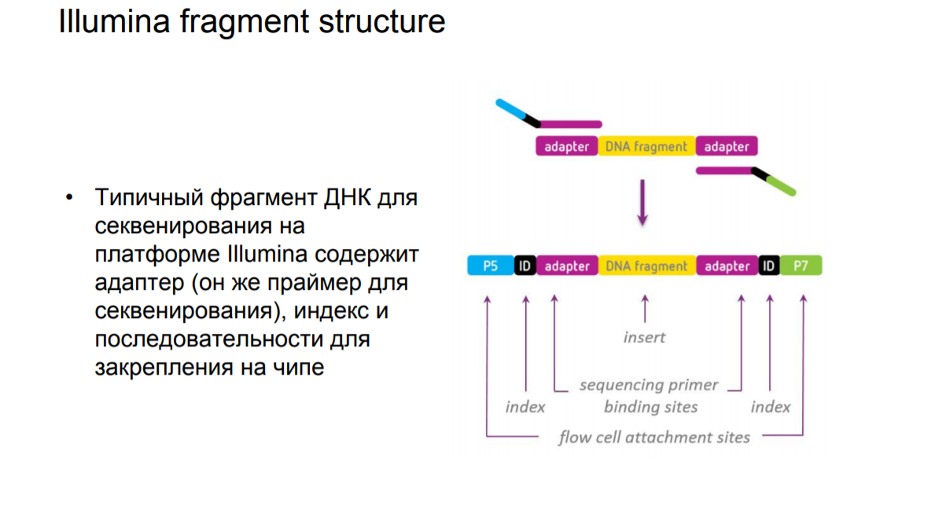

Slide 32
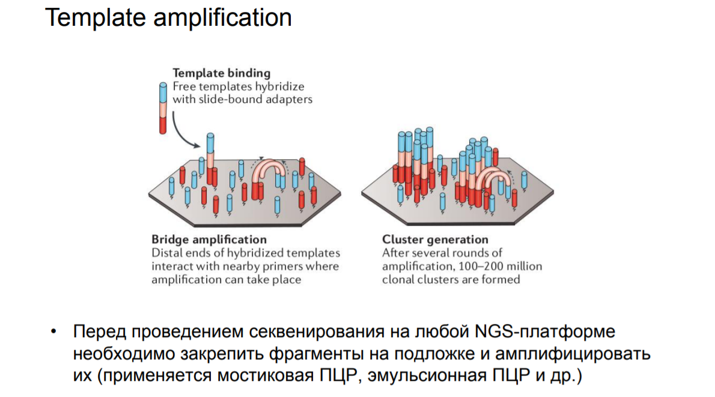

Slide 33
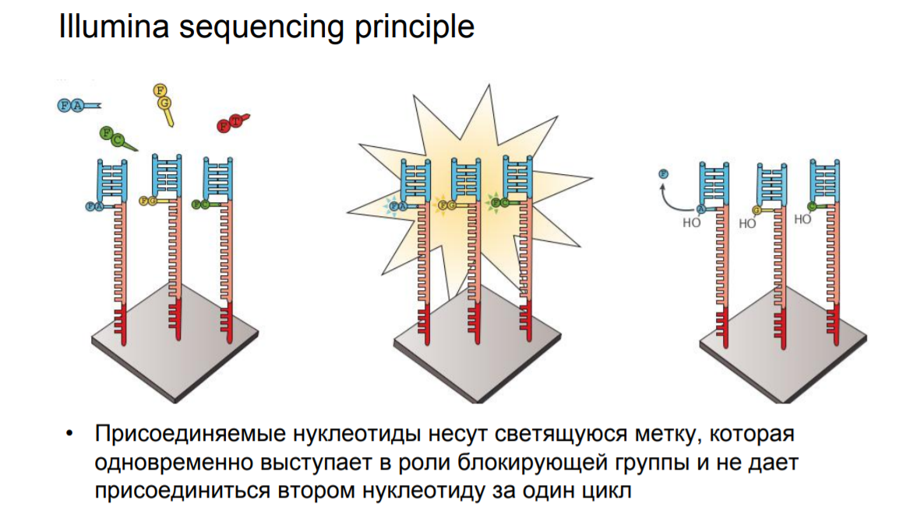

Slide 34
Sequencing by Synthesis (SBS)
G A T T C A G

Slide 35
Solexa Sequencing
C
G A T T C A G

Slide 36
Solexa Sequencing
C
G A T T C A G

Slide 37
Solexa Sequencing
C T
G A T T C A G

Slide 38
Solexa Sequencing
C T
G A T T C A G

Slide 39
Solexa Sequencing
C T A
G A T T C A G

Slide 40
Solexa Sequencing
C T A
G A T T C A G

Slide 41
Solexa Sequencing
C T A A
G A T T C A G

Slide 42
Solexa Sequencing
C T A A
G A T T C A G

Slide 43
Solexa Sequencing
C T A A G
G A T T C A G

Slide 44
Solexa Sequencing
C T A A G
G A T T C A G

Slide 45
Solexa Sequencing
C T A A G T
G A T T C A G

Slide 46
Solexa Sequencing
C T A A G T
G A T T C A G

Slide 47
Solexa Sequencing
C T A A G T C
G A T T C A G

Slide 48
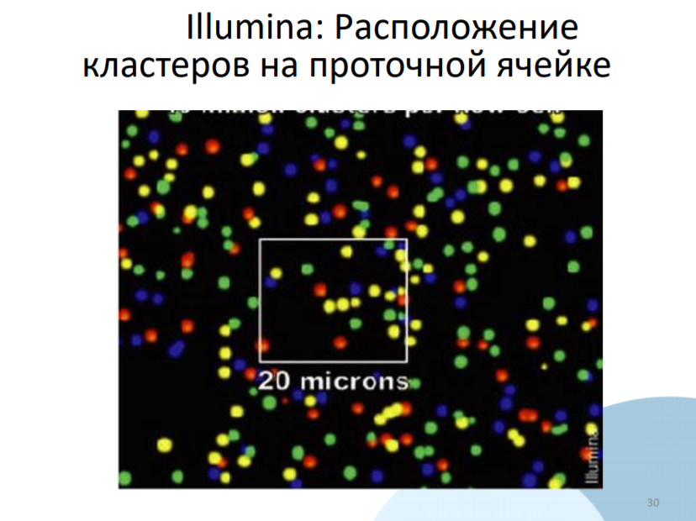

Slide 49
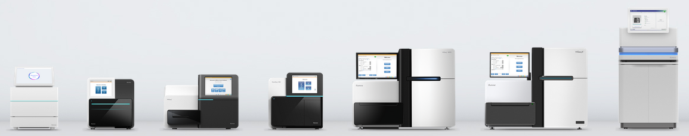
Different sequencers, same chemistry

Slide 50
Sequencing Library Structure
Barcode
Adapter
Insert
Adapter
Barcode
Read 1
Primer
Single End Run
(one fastq file)
Adapter
Insert
Read 2
Primer
Paired End Run
(two fastq files)
Insert
Adapter
Used to separate libraries – often don't see the fastq file
Barcode Read

Slide 51
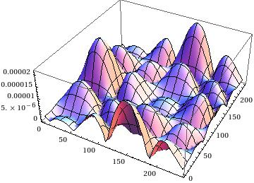

Base calling
A
G
C
T
1. Cluster identification by local maxima of intensity values
2. Background subtraction – noise removal
3. Correction for image shifts and scaling
Scaling
Cycle 1
Cycle 2
Cycle 1
Cycle 2
Shifts

Slide 52
Other factors reducing quality
Cluster overlaps
A
G
C
T
A
A
G
C
T
T
A
A
G
T
T
A
C
A
G
C
T
T
A
A
G
C
T
T
A
G
C
Asynchrony
C
T
C
C
C
T
T
A

Slide 53
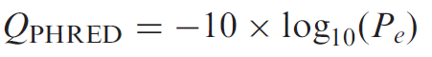
PHRED program
The PHRED software reads DNA sequencing trace files, calls bases and assigns a quality value to each base called (9,10).
P_{e} = probability of error
QUAL format: stores PHRED quality scores as integers
>SRR014849.1 EIXKN4201CFU84 length=93
GGGGGGGGGGGGGGGGCTTTTTTTGTTTGGAACCGAAAGGGTTTTGAATTTCAAACCCTTTTCGGTTTCCAACCTCCAAAGCAATGCCAATA
>SRR014849.1 EIXKN4201CFU84 length=93
18 10 5 3 2 1 1 1 1 1 1 1 1 1 1 1 22 37 31 22 16 11 6 1 26 34 30 11 33 26 30 21 33 26 25 36 32 16 36 32 16 36 32 20 6 24 33 25 30 25 2 24 36 32 15 35 31 17 36 32 20 6 25 29 20 30 25 4 32 26 32 23 32 26 30 24 33 26 35 31 14 28 27 30 22 28 24 27 17 32 23 28 28

Slide 54
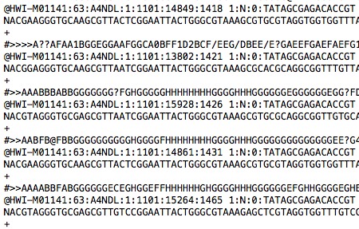
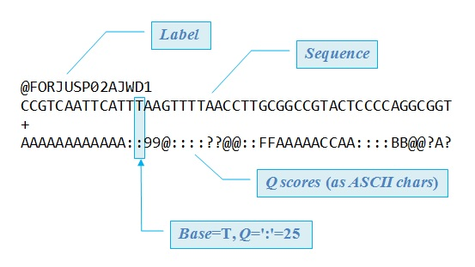
FASTQ format
The FASTQ format was invented at the turn of the century at the Wellcome Trust Sanger Institute by Jim Mullikin, gradually disseminated, but never formally documented (Antony V. Cox, Sanger Institute, personal communication 2009).

Slide 55
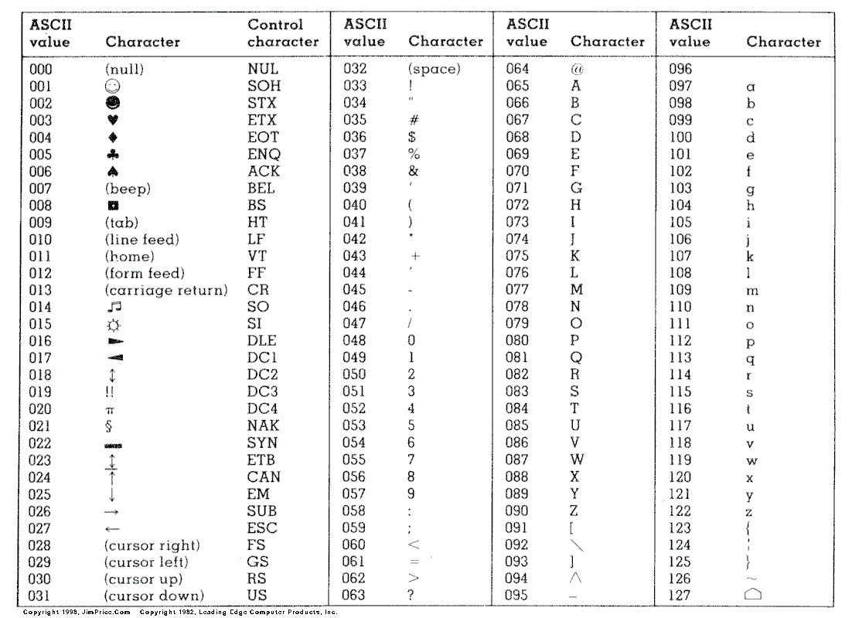
‘fastq-sanger’ quality score format
Stores PHRED scores as a single character:
ASCII space 33-126
=
PHRED scores 0-93
=
P_{e} in 1 - 10^{-9.3}

Slide 56
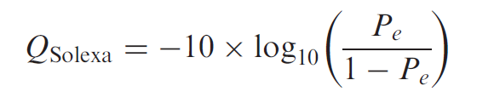
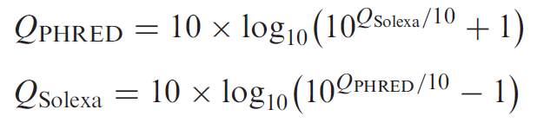
‘solexa-fastq’ quality score format
Solexa quality score definition
Compare with Sanger:
Score mapping
Interchangeable scores for PHRED and Solexa for values > 10
Scores can go down to -5.
The ASCII range 59-126 (Solexa values -5 to 62)

Slide 57
‘fastq-illumina’ quality score format
Illumina 1.3+ machines
Used PHRED quality scores (not Solexa)
But used offset of 64, instead of 33 (like in Sanger format) =>
Holds PHRED scores 0 to 62 (ASCII 64-126)
Currently raw Illumina data scores are expected in the range 0-40

Slide 58
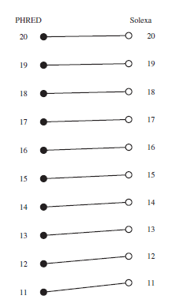


Format comparison

Slide 59
FASTQ file definition
@SRR014849.1 EIXKN4201CFU84 length=93 GGGGGGGGGGGGGGGGCTTTTTTTGTTTGGAACCGAAAGGGTTTTGAATTTCAAACCCTTTTCGGTTTCCAACCTTCCAAAGCAATGCCAATA
+SRR014849.1 EIXKN4201CFU84 length=93 3+&$#"""""""""""7F@71,’";C?,B;?6B;:EA1EA1EA5’9B:?:#9EA0D@2EA5’:>5?:%A;A8A;?9B;D@/=<?7=9<2A8==
@title and optional description
sequence line(s)
+optional repeat of title line
quality line(s)
Warning: ‘@’ appears in the beginning of the sequence title, as well as in the quality scores.

Slide 60
FASTQC
Documentation

Slide 61


Basic statistics
Good Illumina data
Bad Illumina data
Warning
Basic Statistics never raises a warning.
Failure
Basic Statistics never raises an error.
Common reasons for warnings
This module never raises warnings or errors

Slide 62


Per Base Sequence Quality
Good Illumina data
Bad Illumina data
FastQC attempts to automatically determine which encoding method was used, but in some very limited datasets it is possible that it will guess this incorrectly (ironically only when your data is universally very good!)
Good
Reasonable
Poor quality
Warning
lower quartile for any base is less than 10
median for any base is less than 25
Failure
lower quartile for any base is less than 5
median for any base is less than 20
Common reasons for warnings
general degradation of quality over the duration of long runs
Solution: quality trimming = read truncation
a short loss of quality earlier in the run, because of
Transient problems: e.g. bubbles
Solution: masking ; trimming not advisable
Reads of varying length:
Solution: check the read length distribution module

Slide 63


Per Sequence Quality Scores
Good Illumina data
Bad Illumina data
Warning
most frequently observed mean quality is below 27 (0.2% error rate)
Failure
most frequently observed mean quality is below 20 (1% error rate)
Common reasons for warnings
Systematic problems – e.g. one end of flowcell
Solution: look at per-tile sequence quality module, check modality of the distribution
general loss of quality within a run
Solution: For long runs this may be alleviated through quality trimming

Slide 64


Per Base Sequence Content
Good Illumina data
Bad Illumina data
Common reasons for warnings
Biased fragmentation: biased sequences in the start of the read for some libraries:
produced by random hexamer trimming (Nearly all RNA-seq libraries )
Or fragmented using transposases
Overrepresented sequences:
Adapter dimers, rRNA
Biased composition libraries
sodium bisulphite converting cytosines to thymines
Aggressive adapter trimming
Bias at the end
Warning
difference between A and T, or G and C is greater than 10% in any position
Failure
difference between A and T, or G and C is greater than 20% in any position

Slide 65




Per Sequence GC Content
Good Illumina data
Bad Illumina data
Common reasons for warnings
Systematic biases will shift the distribution but will not produce warnings
Warnings are thrown because of deviation from normal distribution
Sharp peaks on an otherwise smooth distribution
Contamination with adapter dimers
Broader peaks
may represent contamination with a different species.
Warning
sum of the deviations from the normal distribution represents more than 15% of the reads
Failure
sum of the deviations from the normal distribution represents more than 30% of the reads

Slide 66


Per Base N Content
Good Illumina data
Bad Illumina data
Common reasons for warnings
general loss of quality
Solution: Look at other quality modules
high proportions of N at a small number of positions early in the library, against a background of generally good quality
very biased sequence composition in the library to the point that base callers can become confused and make poor calls ??
Warning
N content of any position >5%.
Failure
N content of any position >20%.

Slide 67


Sequence Length Distribution
Good Illumina data
Bad Illumina data
Warning
all sequences are not the same length
Failure
any of the sequences have zero length
Common reasons for warnings
For some sequencing platforms it is entirely normal to have different read lengths so warnings here can be ignored.

Slide 68


Duplicate Sequences
Good Illumina data
Bad Illumina data
Warning
non-unique sequences make up more than 20% of the total
Failure
non-unique sequences make up more than 50% of the total
Common reasons for warnings
technical duplicates arising from PCR artefacts
biological duplicates (repeated DNA sequences)
RNA-seq
Check: the distribution of duplicates in a specific genomic region (after alignment)
Constrained start site?

Slide 69

Overrepresented Sequences
Good Illumina data
Bad Illumina data
No overrepresented sequences
This module lists all of the sequence which make up more than 0.1% of the total
Warning
any sequence is found to represent more than 0.1% of the total
Failure
any sequence is found to represent more than 1% of the total
Common reasons for warnings
Biological significance
Technical contamination
small RNA libraries (generated without fragmentation)

Slide 70


Kmer Content
Good Illumina data
Bad Illumina data
Common reasons for warnings
assumption that any small fragment of sequence should not have a positional bias in its apearance within a diverse library
random priming will nearly always show Kmer bias at the start
If you have very long sequences with poor sequence quality then random sequencing errors will dramatically reduce the counts for exactly duplicated sequences.
If you have a partial sequence which is appearing at a variety of places within your sequence then this won't be seen either by the per base content plot or the duplicate sequence analysis.
Warning
any k-mer is imbalanced with a binomial p-value <0.01.
Failure
ny k-mer is imbalanced with a binomial p-value < 10^-5.

Slide 71



Oxford Nanopore Technologies

Slide 72
Спасибо за внимание

